Slide 1


Big Mountain Resort Ticket Price
Binh Kieu Nguyen
Madrid, Nov 14, 2020
https://github.com/BinhKieu82/DataScienceGuidedCapstone

Slide 2


Agenda
Problem statements
Key Findings & Recommendations
Modeling Results & Analysis
Summary & Conclusions
By Kenneth Jensen - Own work based on:ftp://public.dhe.ibm.com/software/analytics/spss/documentation/modeler/18.0/en/ModelerCRISPDM.pdf (Figure 1), CC BY-SA 3.0, https://commons.wikimedia.org/w/index.php?curid=24930610

Slide 3
Problem Statement Worksheet (Hypothesis Formation)
How Big Mountain Resort (BMR) optimize the ticket price strategy in the market context in order to maximize the return. By building predictive ticket pricing model to provide guidance for BMR’s pricing & future facility investment plans (within 1 month)
H
1
Context
4
Constraints within solution space
Big Mountain Resort (a ski resort in Montana, US) has access 105 trails in Glacier NP & Flathead NF with 350k annual clients. BMR’s just installed a chair lift (cost $1.54mil) to attract more visitors. Pricing strategy ‘s been mainly based on aver price of resorts in the maker segment while ignoring other factors like facilities utilization. Decision makers need a guidance on the ticket price’s components breakdown & predictive pricing model, by that they can define their ticket price strategy.& future investment plans
Solution in time bounded
2
Criteria for success
5
Stakeholders to provide key insight
Find out the price components to build a predictive model to analyse scenarios & come up with a good ticket price strategy within the time limit
Director of Operations: Jimmy Blackburn Database Manager: Alesha Eisen
3
Scope of solution space
6
Key data sources
Scanning data from 330 resorts in US & other well-known related sources
A given single CSV (330x27)
H
D
E
I
P

Slide 4
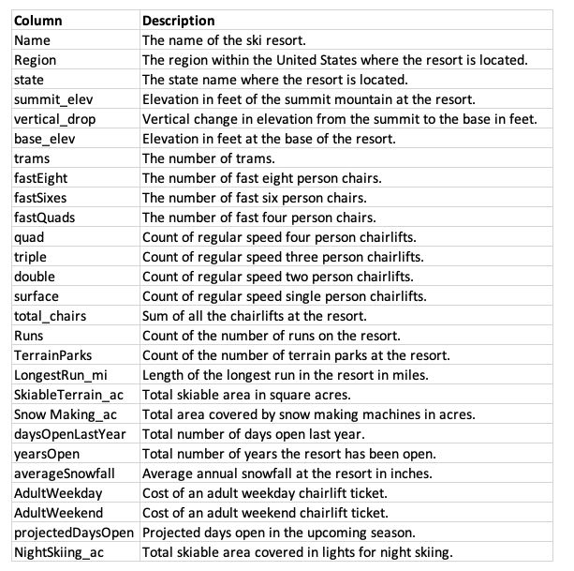
Project Big Mountain Resort Ticket Price
Features Description & Abbreviation
BMR: Big Mountain Resort
LRM: Linear Regression Model
RF Model: Random Forest Regression Model
MAE: Mean Absolute Error
Std: Standard deviation
ski_data

Slide 5
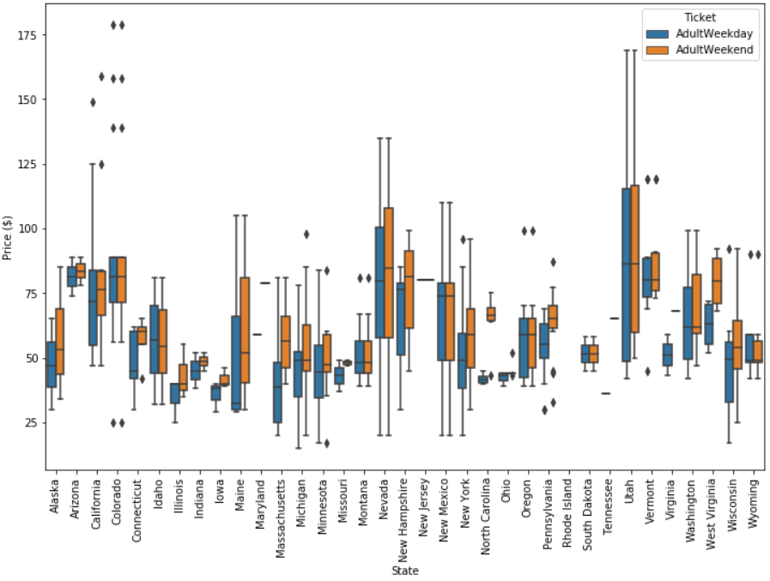
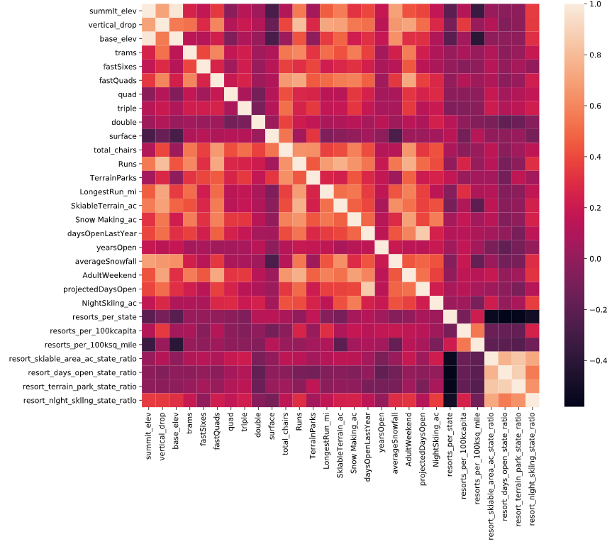
Project Big Mountain Resort Ticket Price
Findings & Recommendations
Montana resorts ticket price range: 38-81$, BMR is 81$, normal market range: 25-100$
Many features have fair to good relationship to ticket prices: vertical_drop, fastQuads, Runs, total_chairs, Snow Making_ac
States Population & area from reputable source (Wikipedia) has been recommended to merge with ski_data.
Features need to be scaled & ready for modeling step

Slide 6
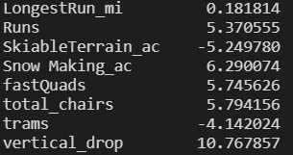
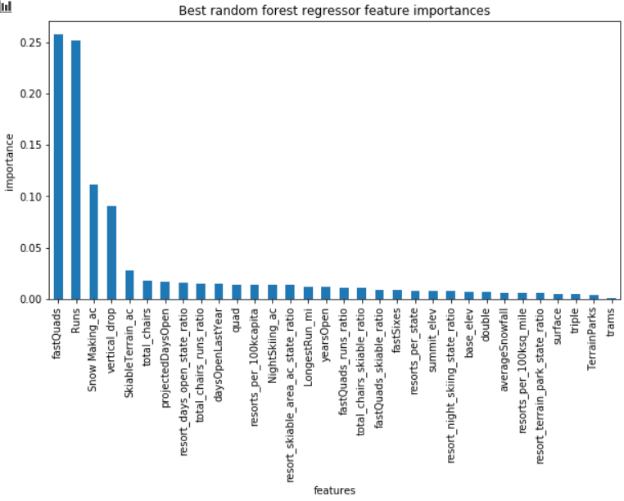
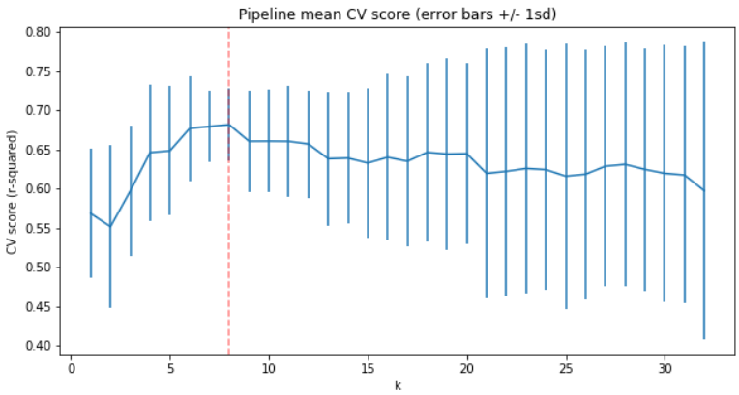
Project Big Mountain Resort Ticket Price
Model Params Analysis
input (x) sets: train & test, shape((193,35), 83,35)); label (y) sets: train & test, shape(193, 83); BMR excluded
Random Forest Regression Model
4 dominant features recommended: fastQuads, Runs, Snow Making_ac, vertical_drop
None-scale input, median imputing method
MAE = 9.4955, mean = 9.6595, std = 1.3496
Linear Regression Model
8 dominant features:
Scale input, median imputing method
MAE = 11.7935, mean = 10.499, std = 1.622

Slide 7
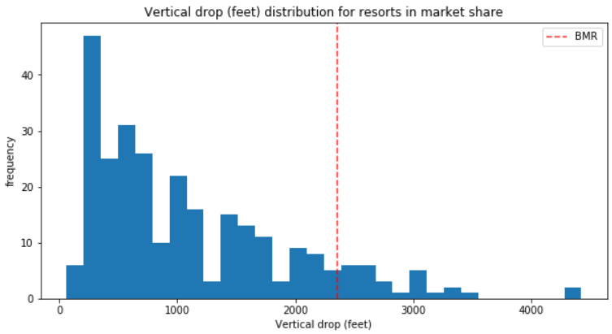
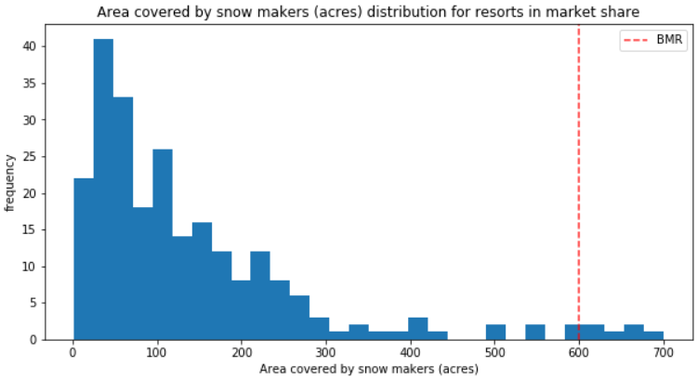
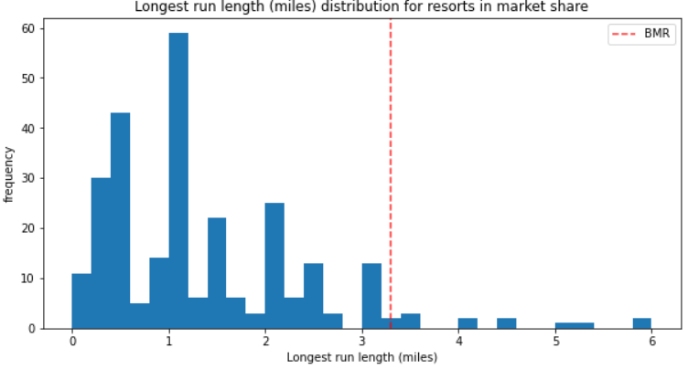
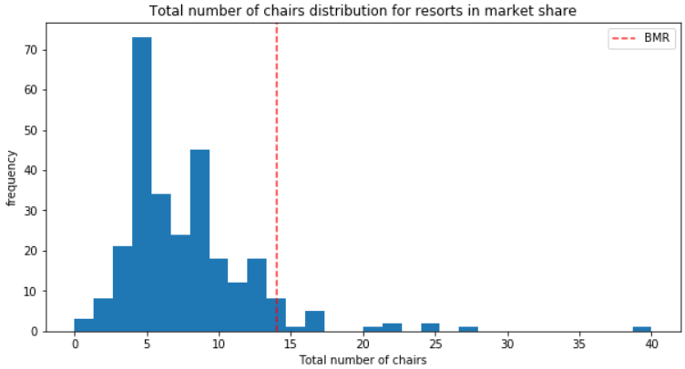
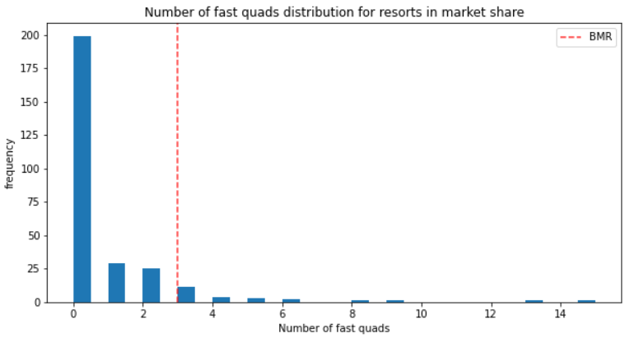
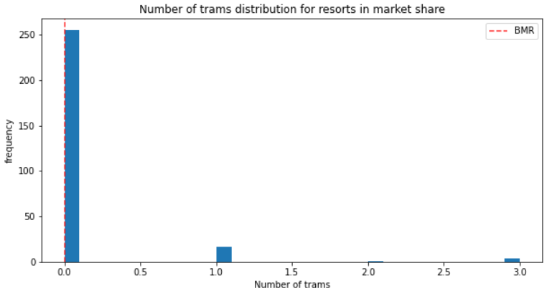
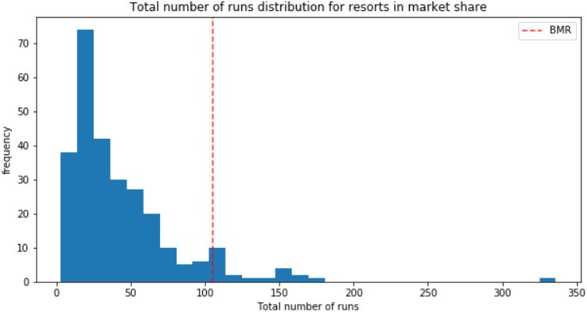
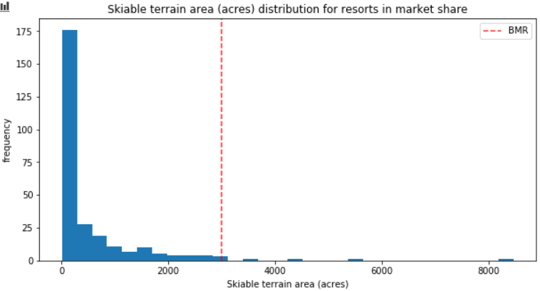
Project Big Mountain Resort Ticket Price
RF Model Params in Market Context
Features: vertical_drop, Snow Making_ac, total_chairs, Runs, LongestRun_mi, trams, Skiable terraince_area, fas quards

Slide 8
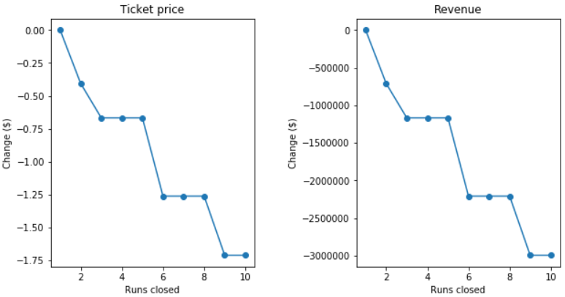
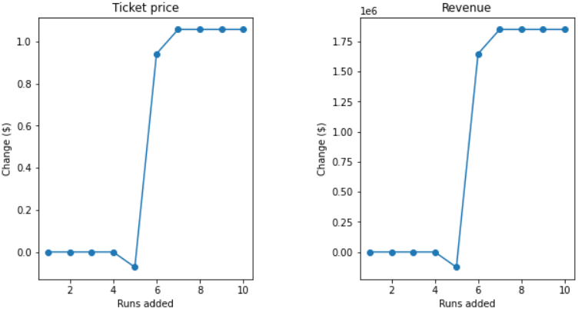
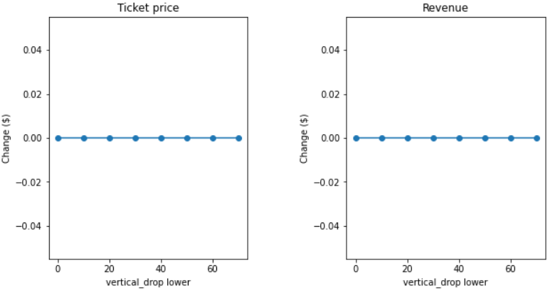
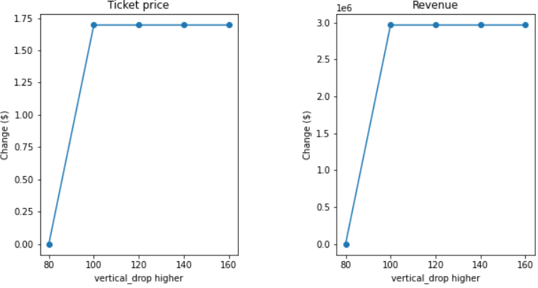
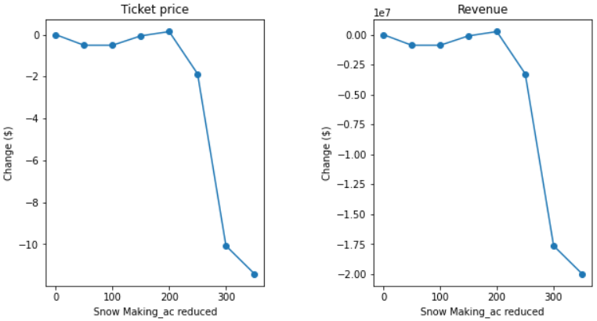
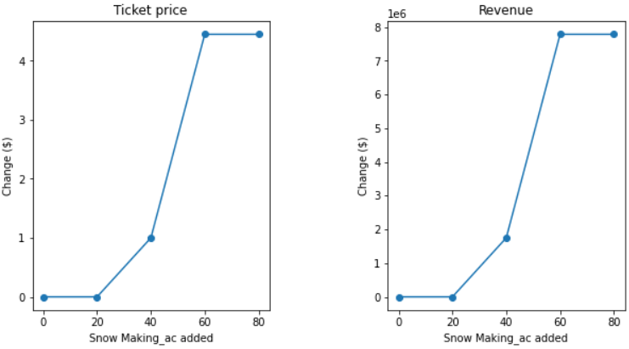
Project Big Mountain Resort Ticket Price
Model Params Filtering
Features (Runs, vertical_drop, Snow Making_ac, total_chairs) show significant changes in ticket price & revenue
Revenue & price are positive correlation

Slide 9
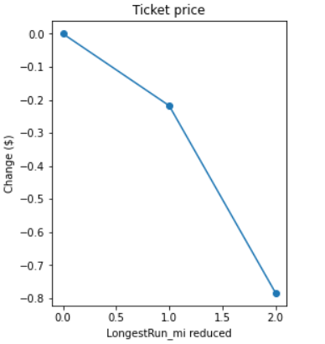
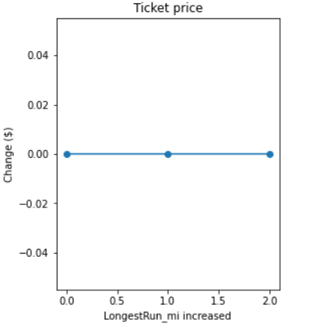
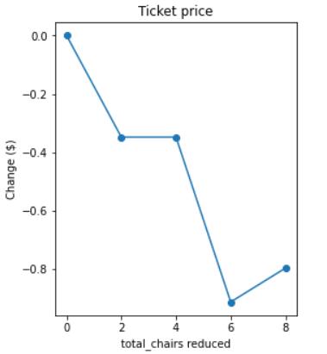
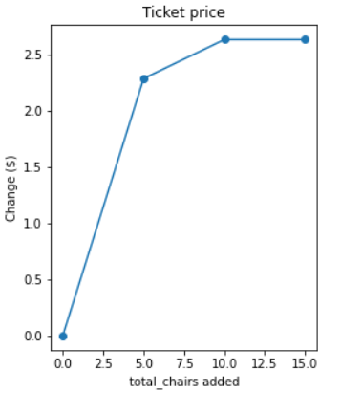
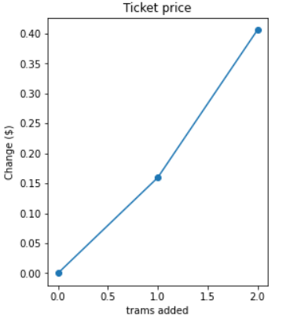
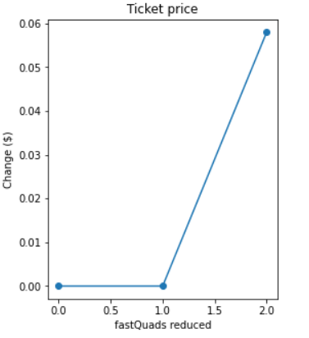
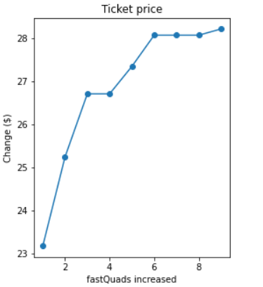
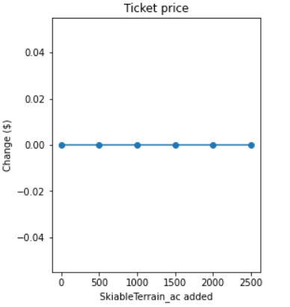
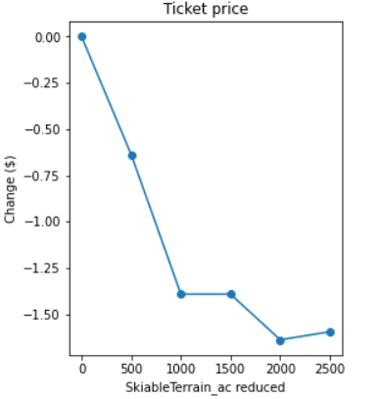
Project Big Mountain Resort Ticket Price
Model Params Filtering
Features (total_chairs, LongestRun_mi, fastQuads, trams, SkiableTerrain_ac)
The rest of features are not feasible to change
total_chairs feature shows s a significant effect on revenue & price.

Slide 10
Project Big Mountain Resort Ticket Price
RF Model Deployment in Market Context
- 04 modeling scenarios have been suggested basing on strategy of using these features: vertical_drop, Snow Making_ac, total_chairs, Runs, LongestRun_mi
Case 01: Permanently closing down up to 10 of the least used runs. Decrease $3mil Rev
Case 03: Same as case 2, but adding 2 acres of snow making cover. Same as case 02
Case 04: Increase the longest run by 0.2 mile to boast 3.5 miles length, requiring an additional snow making coverage of 4 acres. Same as case 02
Case 02: Increase the vertical drop by adding a run to a point 150 feet lower down but requiring the installation of an additional chair lift to bring skiers back up, without additional snow making coverage. Increasing: Ticket $1.99, Revenue $3474638

Slide 11
Project Big Mountain Resort Ticket Price
Modeling Results & Analysis
BMR price has been predicted is $95.87 using Random Forest model excluding BMR info vs $81 actual one. It means that it still has room to increase ticket price then revenue.
04 scienarios have been run to reveal the variation of ticket price when key features/facilities change. The results showing that number of Runs, vertical_drop & total_chairs are the most effected features to the ticket price & revenue. The suggested price increase is $1.9 leading an increasing of $3474638 in revenue over a season.
Continue running the model by increasing number of Runs, an interesting number of revenue increase is $5123188 meanwhile ticket price is only higher $2.93. By playing around with many other cases might reach an optimum solution.

Slide 12
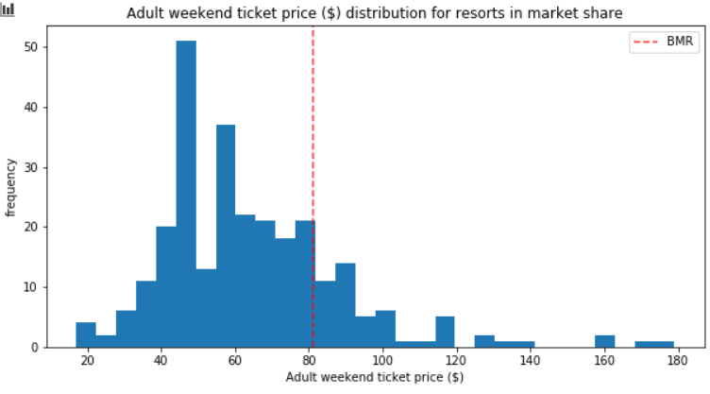
Project Big Mountain Resort Ticket Price
Summary & Conclusions
The suggested price increase is $1.9 leading an increasing of $3474638 in revenue over a season
Other regression models are recommended to use

